Slide 1

EXPLAINABLE AI-BASED CREDIT CARD FRAUD DETECTION AND RISK ANALYSIS
CSA1704 – ARTIFICIAL INTELLIGENCE
GUIDED BY
DR.M. ANOOP
PRESENTED BY
MITHRA DEVI S – 192524203
BODHAM SUSMA - 192571065

Slide 2
ABSTRACT
Uses Artificial Intelligence (AI) to detect fraudulent credit card transactions.
Analyzes amount, time, location, frequency, and customer behavior.
Identifies unusual transaction patterns and suspicious activities.
Generates a fraud risk score for each transaction.
Uses Explainable AI (XAI) to provide reasons for fraud predictions.
Helps reduce financial losses and improve transaction security.
Provides a transparent, accurate, and reliable fraud detection system.

Slide 3
INTRODUCTION
Credit card fraud is a major financial security problem that causes significant losses to customers and financial institutions.
Traditional fraud detection methods may not effectively identify new and hidden fraud patterns.
Artificial Intelligence (AI) can analyze large amounts of transaction data and identify suspicious activities.
The proposed system analyzes factors such as transaction amount, time, location, frequency, and customer behavior.
It generates a fraud risk score to identify the possibility of fraudulent transactions.
Explainable AI (XAI) provides clear reasons behind the AI's prediction.
The system aims to improve fraud detection, transparency, security, and risk analysis.

Slide 4
EXISTING SYSTEM
Traditional systems mainly use rule-based methods to detect credit card fraud.
Fraud is identified using predefined rules and transaction limits.
These methods may fail to detect new and complex fraud patterns.
Large transaction data requires significant manual monitoring.
Existing systems may generate false alerts for legitimate transactions.
They often provide limited explanation for why a transaction is marked as fraudulent.
Therefore, there is a need for a more intelligent, accurate, and explainable AI-based system.

Slide 5
DISADVANTAGES
Requires a large and high-quality dataset for accurate detection.
AI models may sometimes produce false positives or false negatives.
Fraud patterns can change over time, requiring regular model updates.
Processing large transaction data may require high computational resources.
Protecting sensitive customer and transaction data is challenging.
Explainable AI may not always provide perfectly understandable explanations.
Initial development and maintenance can be complex and costly.

Slide 6
PROPOSED SYSTEM
Uses Artificial Intelligence (AI) to detect fraudulent credit card transactions.
Analyzes transaction amount, time, location, frequency, and customer behavior.
Identifies unusual and suspicious transaction patterns.
Generates a fraud risk score for each transaction.
Classifies transactions as Fraudulent or Legitimate.
Uses Explainable AI (XAI) to show the reasons behind predictions.
Provides a secure, transparent, and reliable fraud detection framework.
Helps financial institutions reduce fraud losses and improve transaction security.

Slide 7
ADVANTAGES
Early fraud detection of suspicious transactions.
Improved accuracy in identifying fraudulent activities.
Detects unusual and hidden patterns.
Provides a fraud risk score for transactions.
Explainable AI improves transparency and trust.
Helps reduce financial losses.
Enhances credit card and transaction security.
Supports faster and smarter decision-making.
Reduces manual monitoring efforts.

Slide 8
PROBLEM STATEMENT
Credit card fraud causes financial losses to customers and institutions.
Traditional methods may fail to detect new and complex fraud patterns.
Suspicious transactions are difficult to identify from large transaction data.
There is a need to analyze amount, time, location, frequency, and customer behavior.
The system should provide a fraud risk score for each transaction.
AI should classify transactions as fraudulent or legitimate.
XAI should provide clear reasons for the fraud prediction.
The system should improve security, accuracy, and transparency.

Slide 9
OBJECTIVES
To develop an AI-based system for detecting credit card fraud.
To analyze transaction and customer behavior.
To identify suspicious and unusual transaction patterns.
To generate a fraud risk score for each transaction.
To classify transactions as fraudulent or legitimate.
To use Explainable AI (XAI) to explain fraud predictions.
To reduce financial losses and false alerts.
To improve transaction security, accuracy, and transparency.

Slide 10
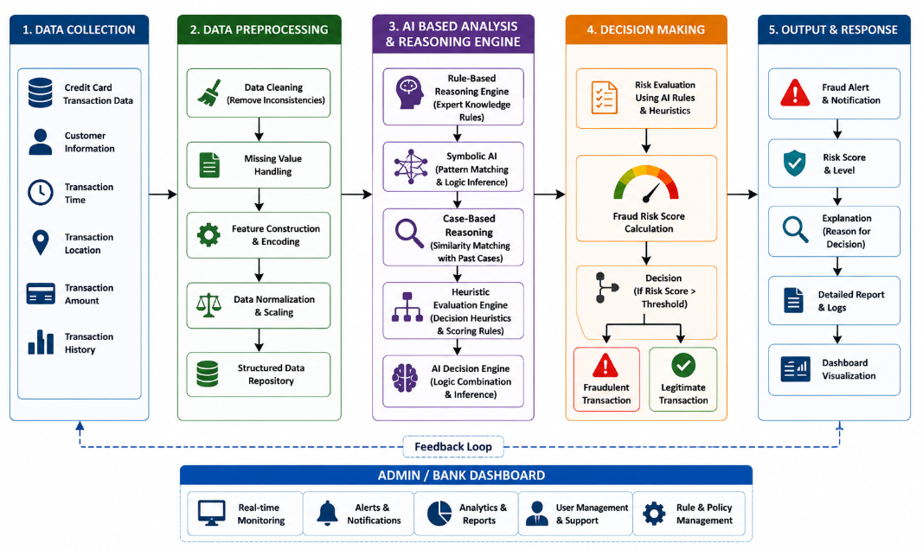
SYSTEM ARCHITECTURE

Slide 11

MODULE 1-DATA COLLECTION & PREPROCESSING
Collect credit card transaction data such as amount, time, location, frequency, and customer behavior.
Clean the data by removing duplicates and incorrect records.
Handle missing values and convert categorical data into usable format.
Perform feature selection and normalization.
Prepare clean and structured data for the AI system.
Algorithm : Data Preprocessing Algorithm
Technique Used: Cleaning, Encoding, Normalization & Feature Selection.
Output: Preprocessed transaction data ready for AI-based fraud detection.
Formula:

Slide 12

MODULE 2 - FRAUD DETECTION AND RISK PREDICTION
Analyze transaction data to identify suspicious patterns.
Apply AI rules based on amount, time, location, frequency, and customer behavior.
Calculate a fraud risk score.
Classify transactions as Fraudulent or Legitimate.
Assign Low, Medium, or High risk levels.
Algorithm: Rule-Based Expert System
Technique Used: Rule-Based Reasoning, Pattern Analysis & Risk Scoring
Output: Fraud classification with risk score and risk level.
Formula:

Slide 13
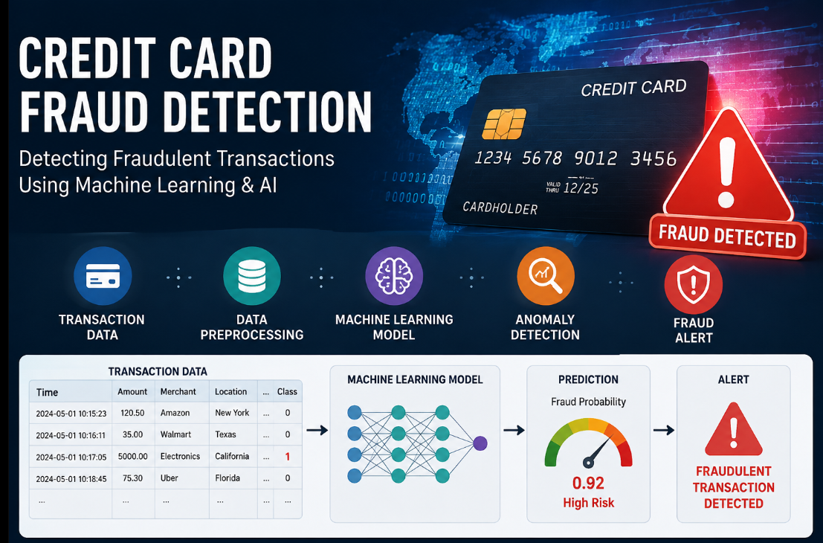
DATA SET
DATASET NAME :Credit Card Fraud Detection Dataset
Records: 850
Features: 30
Format: CSV
Contains transaction amount, time, location, frequency, and customer behavior.
Includes merchant details and transaction history.
Contains fraud-related indicators for identifying suspicious transactions.
Includes a fraud label to classify transactions as legitimate or fraudulent.
Used for AI-based fraud detection, risk scoring, and XAI analysis.

Slide 14
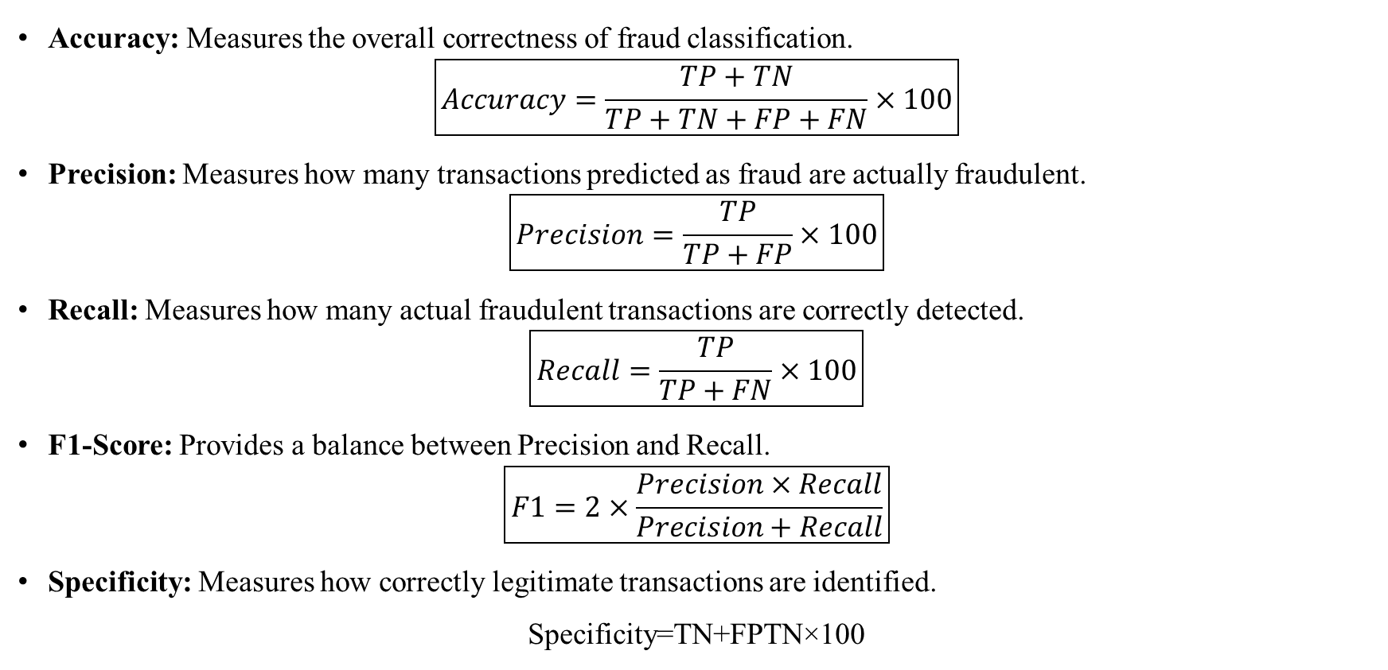
PERFORMANCE METRICS
Accuracy: Measures the overall correctness of fraud classification.
$$\boxed{Accuracy=\frac{TP+TN}{TP+TN+FP+FN}×100}$$
Precision: Measures how many transactions predicted as fraud are actually fraudulent.
$$\boxed{Precision=\frac{TP}{TP+FP}×100}$$
Recall: Measures how many actual fraudulent transactions are correctly detected.
$$\boxed{Recall=\frac{TP}{TP+FN}×100}$$
F1-Score: Provides a balance between Precision and Recall.
$$\boxed{F1=2×\frac{Precision×Recall}{Precision+Recall}}$$
Specificity: Measures how correctly legitimate transactions are identified.
Specificity=TN+FPTN​×100​

Slide 15
FUTURE ENHANCEMENT
Integrate real-time fraud detection for instant transaction monitoring.
Improve AI rules to detect new and complex fraud patterns.
Add real-time alerts and notifications for high-risk transactions.
Develop a mobile and web dashboard for monitoring fraud activities.
Enhance XAI explanations for clearer fraud decisions.
Integrate dynamic risk scoring based on changing customer behavior.
Support multiple banks and payment platforms.
Improve system security, scalability, and reliability.

Slide 16
CONCLUSION
The proposed system uses Artificial Intelligence to detect fraudulent credit card transactions.
It analyzes transaction details and customer behavior to identify suspicious activities.
The AI Rule-Based Expert System generates a fraud risk score and classifies transactions.
Explainable AI (XAI) provides understandable reasons for fraud predictions.
The system helps reduce financial losses and improve transaction security.
Overall, it provides a transparent, reliable, and effective solution for credit card fraud detection and risk analysis.

Slide 17
REFERENCES
Cavdar, E.Z. and Bozanta, A., 2026. AI-based credit card fraud detection: a machine learning approach with model explainability on real-world data. Knowledge and Information Systems, 68(1), p.161.
Ikermane, M., Mohy-eddine, M. and Rachidi, Y., 2024, December. Credit Card Fraud Detection: Comparing Random Forest and XGBoost Models with Explainable AI Interpretations. In International Conference on Electrical Systems and Smart Technologies (pp. 126-135). Cham: Springer Nature Switzerland.
Adhegaonkar, V.R., Thakur, A.R. and Varghese, N., 2024, January. Advancing credit card fraud detection through explainable machine learning methods. In 2024 2nd International Conference on Intelligent Data Communication Technologies and Internet of Things (IDCIoT) (pp. 792-796). IEEE.

Slide 18


